Slide 1

Secure END to End Encryption Chat program “Enigma”
The Elder: Zheng Xu, Yue Qiao, BingXuan Ying

Slide 2
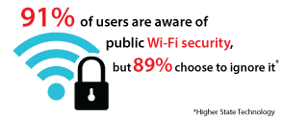
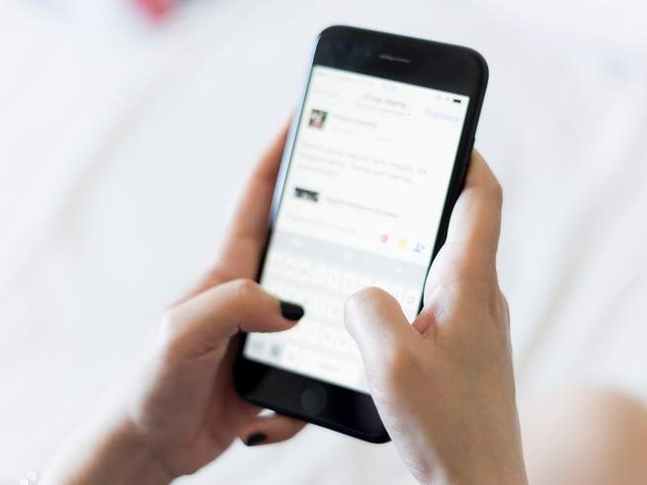
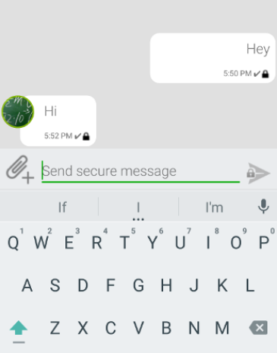
Security is a Big Problem in chatting!

Slide 3
Potential problems in this areas
1. Ethical reasons
2. Political reasons
Many…

Slide 4



Some apps you might know!

Slide 5

Some apps you Don’t know!
ENIGMA

Slide 6
Say hi to our “Enigma”!
Straight forward!
Encryption method we should all be familiar with. (AES, RSA)
3. No one knows your message!

Slide 7
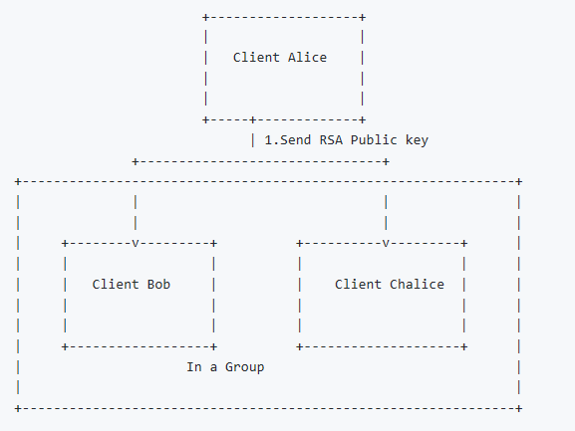
General Work Flow(1)

Slide 8
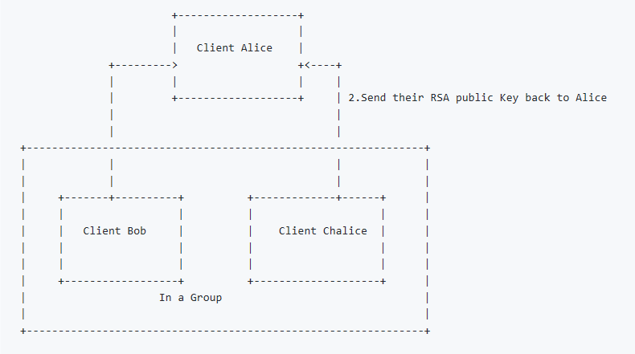
General Work Flow(2)

Slide 9
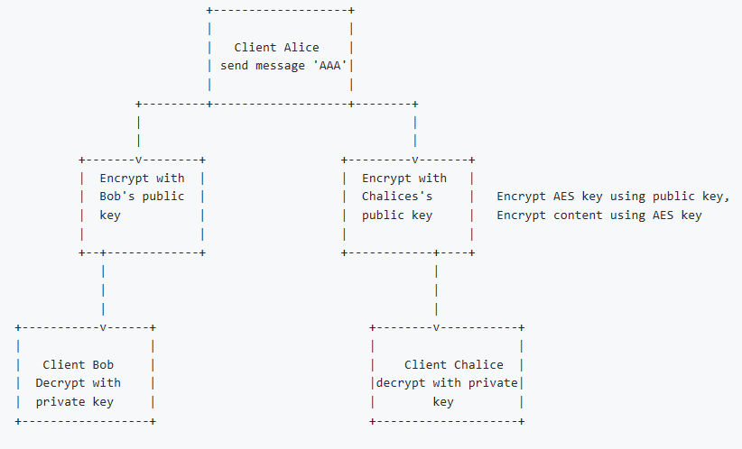
General Work Flow(3)

Slide 10
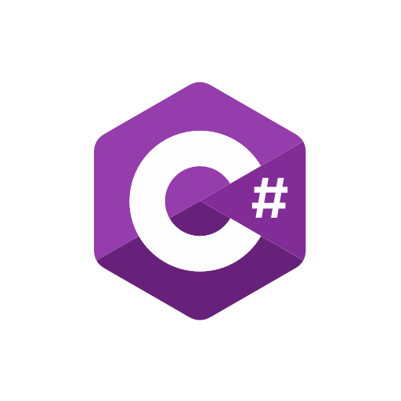
Programming environment
Our program is based on C# language.

Slide 11
Program Design
1.RSA for AES-key Encryption.
2.AES-256 for Message Encryption.
Encryption and decryption functions are stored in EnigmaLib folder.

Slide 12
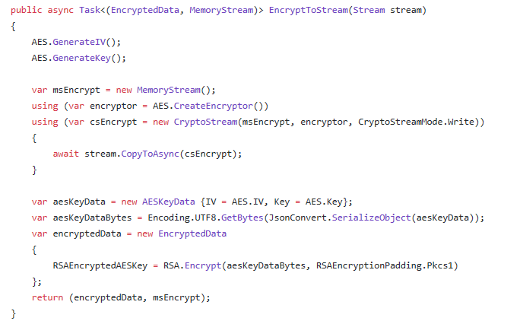
Partial code example of our AES-encryption method.

Slide 13
Program Design
EnigmaServer is the folder contains the database and mostly AIPs for clients. (Such as sending or receiving messages. )

Slide 14
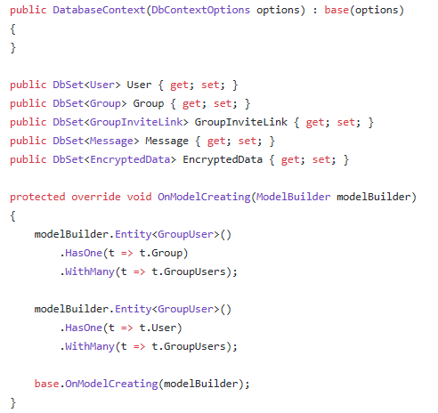
Partial code for setting up our database.

Slide 15
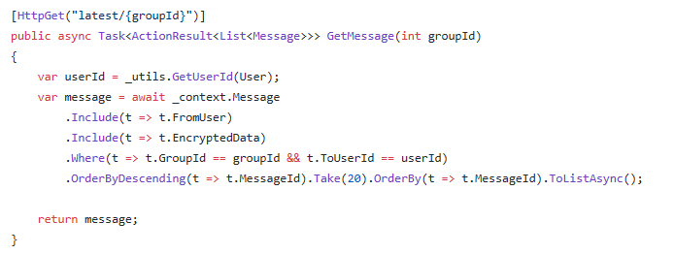
Partial code for getting the latest 20 messages.

Slide 16
Program Design
EnigmaClientCli is the folder contains our Async methods and some errors handlers.
It also contains the basic UI , commands read-ins and some User level APIs.

Slide 17
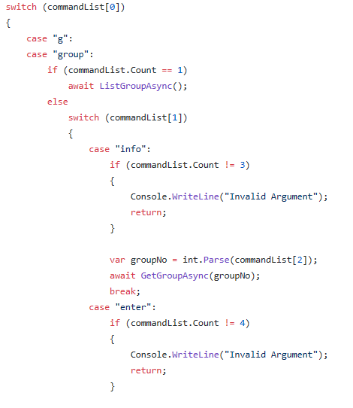
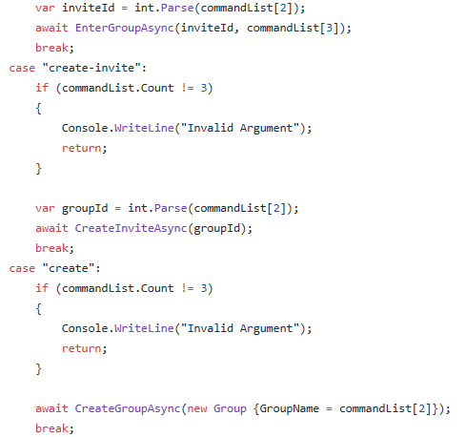
Partial code for our commands list.
Create groups, create invites ,etc.

Slide 18
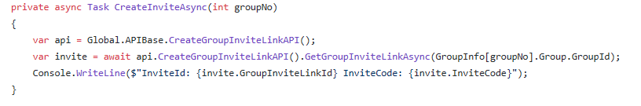
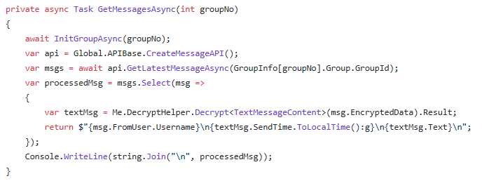
Partial code for creating invites and getting messages.

Slide 19
Program Design
EnigmaTest is our playground for testing. This is the place where we write our testcases for debugging and performance evaluations.

Slide 20
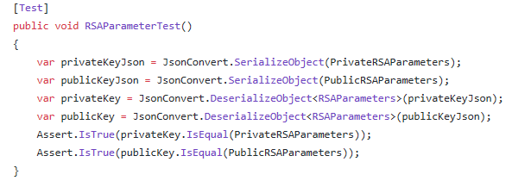
Partial code for testing our RSA parameters.

Slide 21
Program DEMO

Slide 23
Conclusion
“Enigma” is best end-to-end encryption program we can make by far.
No adversary should be able to steal your message while using our app.
More features can be added into our apps.
Please kindly let us know if there are bugs while using the app.
Welcome to use it or break it! ☺

Slide 24


